Slide 1
Wifi Embedded Webcam
Kishan Jaishwal (20)
Prajwol Lamichhane (26)
Anukul Parajuli (34)
Abhay Raut (43)
Subarna Subedi (55)
Notes:
1

Slide 2
What / Why “Wifi Embedded Webcam”?
What : A WIFI embedded webcam is a camera that sends live pictures or videos to a computer through a network.
Why: To visualize its importance and demonstrate how small ideas can really make changes

Slide 3
Objectives
To know how an internet based webcam system is developed that allows people to view activities around their offices and homes on their WIFI connected laptop or mobile devices
To learn how the security around house and offices are increased through the continuous
live stream of the real time video sent from the webcam via the internet
To learn more about how embedded systems work and how they are used in real life situations
To develop ideas for its further enhancement which could be implemented in other sectors

Slide 4
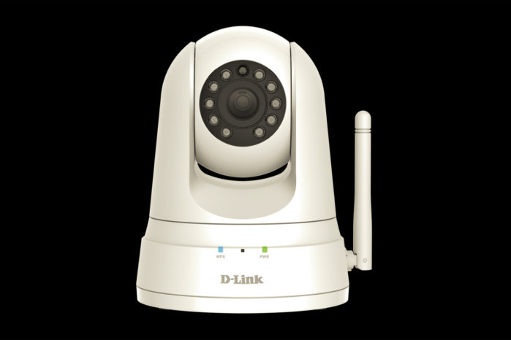
Related Works
A. D-Link Camera
Features:
1. Easy Setup
2. Motion Detection
3. Scheduling
4. Remote Viewing
5. Smart Alerts

Slide 5
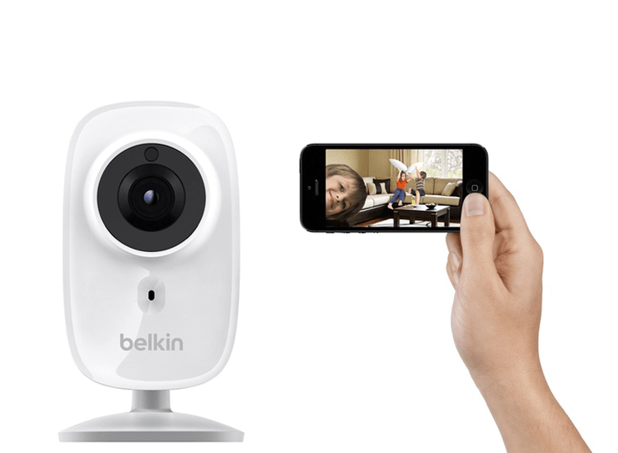
Related Works
B. Belkin NetCam HD
Features:
1. Portable
2. Glass Lens
3. Cloud Facilities
4. Easy Setup
5. Night Vision
6. Wide-Angle
7. Motion Sensor

Slide 6
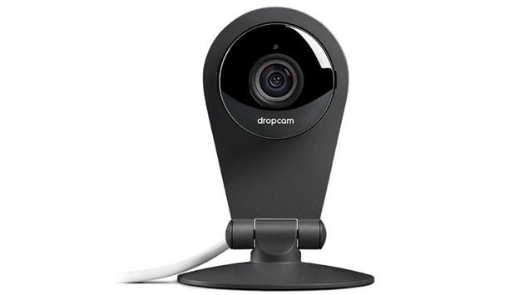
Related Work
DropCam
Features:
1. Can integrate with Alexa
2. 60- second setup
3. Fast and easy setup
4. Wide Angle View
5. Night Vision and Zoom mode

Slide 7
Take Way
Easy to use
Free
Arduino Based Based
Individual friendly
Realtime
Multifunctional

Slide 8
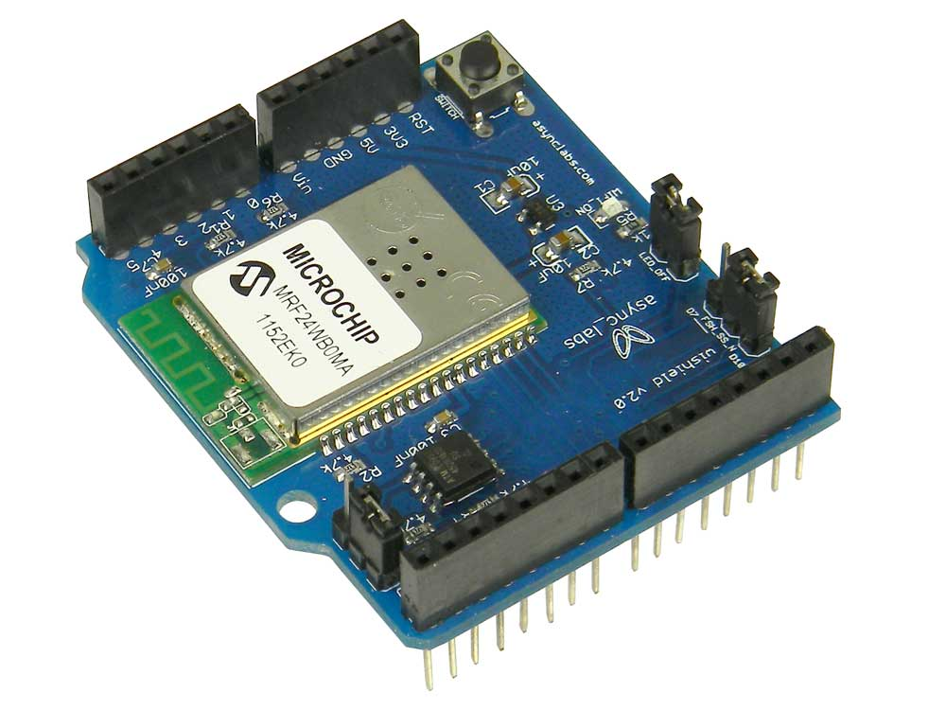
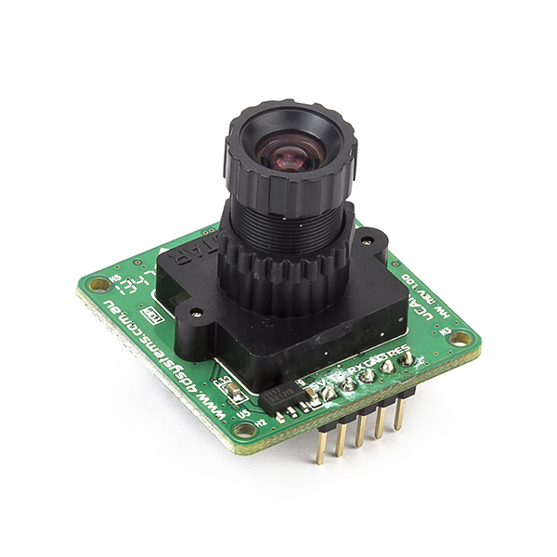
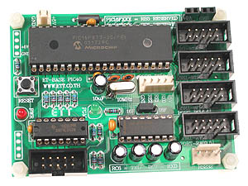
Hardware Used
MRF24WBOMA Wi-Fi module
A Camera module
PIC Controller

Slide 9
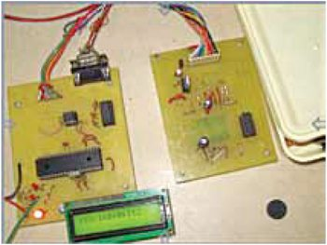
Hardware Used
Fig: WIFI Embedded Webcam

Slide 10
Limitations

Slide 11
Future Enhancement

Slide 12
Conclusion

Slide 13
Thank You

